Slide 1
Explaianable AI using Fold-R++
KAILASH SOMU
KXS200039

Slide 2
Datasets
Iris Classification
BMI Estimation
Stellar Classification
Drug Classification
Success Prediction
Employee Stay Prediction
Insurance Claim Approval
Telecom Churn Prediction
Customer Segmentation
Water Quality Prediction
Diabetes Classification
Stress Detection

Slide 3
Iris Classification - About
Dataset consists of 50 samples from each of three species of Iris (Iris Setosa, Iris virginica, and Iris versicolor)
Dataset contains a set of 150 records under 5 columns namely Petal Length, Petal Width, Sepal Length, Sepal width and Class(Species).
Petal Length, Petal Width, Sepal Length and Sepal width all are numerical features
'Iris-setosa' is the most common occuring target class (33%), so chosen as 'pos'

Slide 4
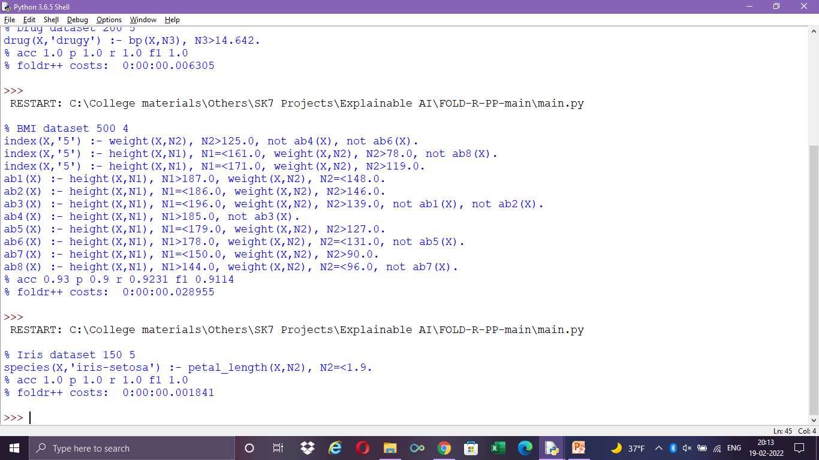
Iris Classification – Fold-R++

Slide 5
Iris Classification- Analysis
Since this is a pretty straight forward dataset, it was easy for the model to come up with just one simple rule to predict the class.
Though the model gave 100% accuracy, the whole prediction depends upon only the 'petal_length' attribute and no other attribute comes into play in prediction which makes it more biased towards 'petal_length'.
This model might fail in real-time if there are different varuations that come up within these 3 species
No abnormal rules insist less complexity in dataset

Slide 6
BMI Estimation - About
To estimate BMI based on Gender, Height & Weight
Dataset consists of 500 records and 4 columns namely Gender, Height, Weight and class(Index)
Gender, Height and Weight are features. Gender is categorical while Height and weight are numerical columns
'5' is the most common occuring target class (39.6%), so chosen as pos

Slide 7
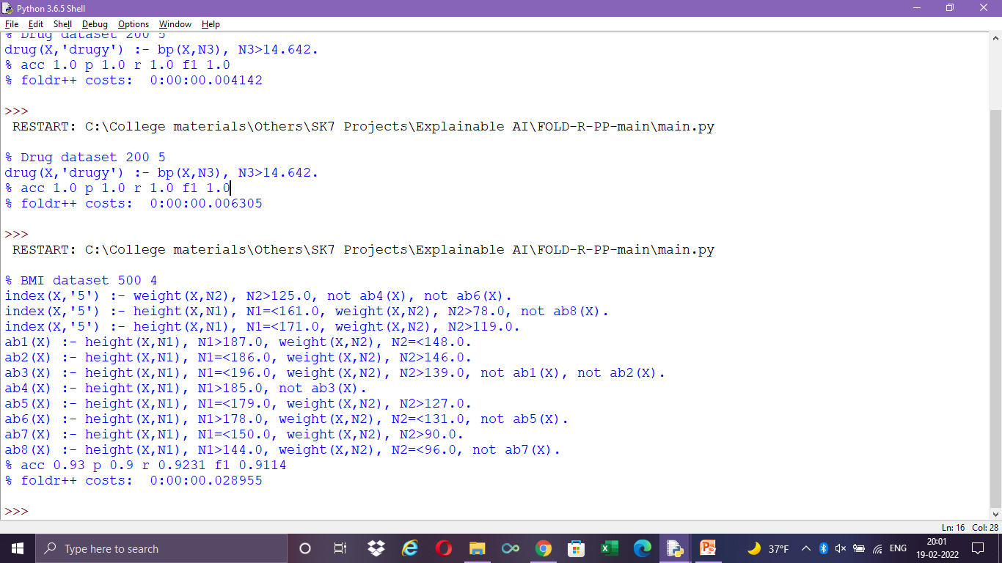
BMI Estimation - Fold-R++

Slide 8
BMI Estimation - Analysis
Model has used all the attributes to predict target
Both Height and Weight are important features for BMI as both the features take part in almost all the rules
'Gender' is the least used attribute in this dataset.
Nine abnormal rules states the complexity of dataset.
Height and Weight are inversely proportional
There are exceptions within exceptions in the rules

Slide 9
Stellar Classification - About
Categorize stars into different categories. Each star will either be classified as Dwarf (0) or Giant (1)
Dataset contains 3642 records and 7 columns namely Vmag, Plx, e_Plx, B-V, SpType, Amag and the class (TargetClass)
Except the ‘SpType, which is the Spectral type, all other features are numerical
Dataset is equally split between dwarf and giant records. So either of these can be used for ‘pos’

Slide 10
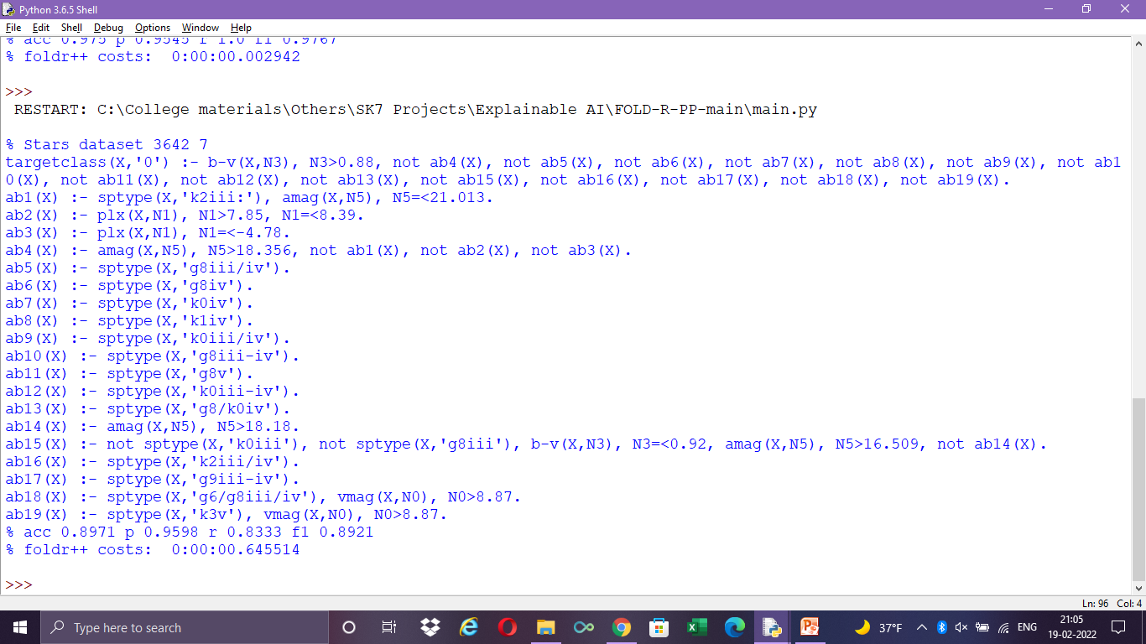
Stellar Classification – Fold-R++

Slide 11
Stellar Classification - Analysis
All the feaures except ‘e_plx’ did take part in the rules
19 abnormalities show the compexity of dataset
Most of the abnormalities are based on sptype
Sptype might have caused the model to overfit and acts as outliers causing more variance
There are exceptions within exceptions in the rules
Recall is lesser than precision for the model which suggests possibilities for tuning the dataset (by preprocessing or tuning hyperparameters)

Slide 12
Drug Classification - About
Suggest drug based on different body features
Dataset contains 200 records and 6 columns namely Age, Sex, BP, cholestrol, Na_to_K and class (Drug)
Age and ‘Na_to_K are numerical features, while other features are categorical
‘DrugY’ is the most common occuring target class (46%), so chosen as pos

Slide 13
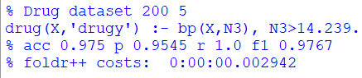
Drug Classification – Fold-R++

Slide 14
Drug Classification - Analysis
The whole prediction depends upon only the bp' attribute and no other attribute comes into play in prediction which makes it more biased towards 'petal_length'.
Since the dataset is small, it was easy for the model to come up with one single rule to give better predictions
‘bp’ attribute is observed to be the important feature
High BP is observed to be suitable for Drug Y
No abnormal rules insist less complexity in dataset

Slide 15
Success Prediction - About
Predict Success in learning a sport based on age and interest score
Dataset contains 297 records and 3 columns namely Age, Interest and class (Success)
Both Age and Interest are numerical features
‘1.0’ is the most occuring target class(56.9%), so chosen as pos

Slide 16
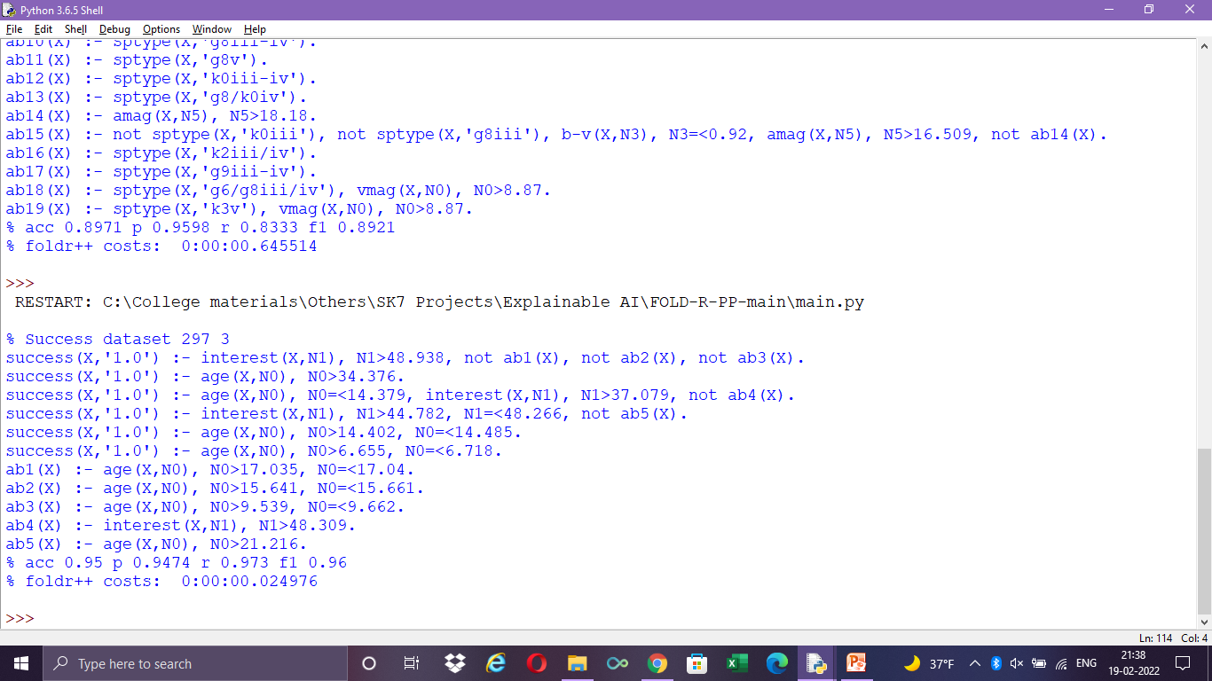
Success Classification – Fold-R++

Slide 17
Sucess Prediction - Analysis
Age seems to be the most influencing factor in learning sports
Inspite of small dataset with just 2 columns and 297 records, there are abnormal cases. This shows the variety in the dataset
There are no excpetions within another exception
All abnormal cases, cover the exception age groups who might fail in learning the sport inspite of having interest to learn

Slide 18
Employee Stay Prediction - About
Predict whether employees would leave company
Dataset contains 4653 records and 9 columns namely Education, JoiningYear , City, PaymentTier, Age, Gender, EverBenched, ExperienceInCurrentDomain and class (LeaveOrNot)
The features JoiningYear, PaymentTier, Age, ExperienceInCurrentDomain are numerical features.
‘0’ is the most occuring target class(65.6%), so chosen as pos

Slide 19
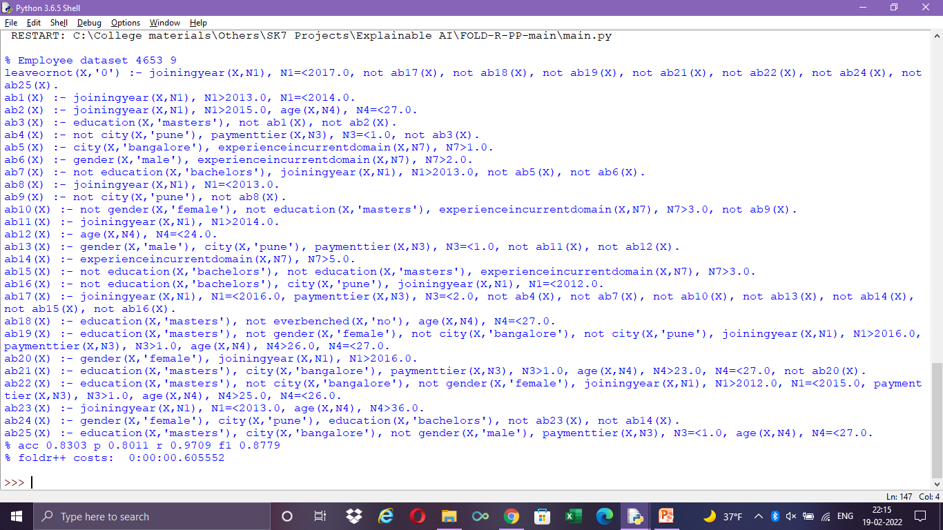
Employee Stay Prediction – Fold-R++

Slide 20
Employee Stay Prediction - Analysis
All features have taken part in the rules. This shows fairness in te rules
25 abnormalities show the complexity of data
Model has very high recall when comapred to accuracy/precision
There are exceptions within exceptions
‘education’ seems to be important feature in the dataset
Year is considered as numeric here. If it had been used as a dateTime object, there are chances for model to improve

Slide 21
Insurance Claim Approval- About
Predict whether travel insurance claim will be approved or not based on different features
Dataset contains 63.3K records and 11 columns namely Agency, Agency Type, Distribution Channel, Product Name, Duration, Destination, Net Sales, Commision, Gender, Age and class (Claim)
The features Duration, Net Sales, Commision, Age are numerical features.
‘0’ is the most occuring target class(98.5%), so chosen as pos (Highly biased towards ‘0’ class)

Slide 22
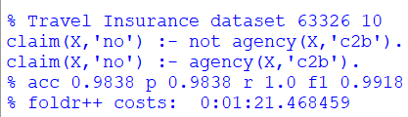
Insurance Claim Approval– Fold-R++

Slide 23
Insurance Claim Approval- Analysis
Since dataset size is too large (63326), took 1minute and 21 seconds to build the rules
Only ‘agency’ feature is used to predict the class. This confirms the bias in the dataset
Since only one of the eleven features is being used for prediction, this model would fail in real time when encountered with different variety of data

Slide 24
Telecom Churn - About
Understand consumer behavior and in-turn predict the association of the customers as whether or not they will leave the company.
Dataset contains 3333 records and 11 columns namely AccountWeeks, ContractRenewal, DataPlan, DataUsage, CustServCalls, DayMins, DayCalls, MonthlyCharge, OvergaeFee and class (Churn)
All the features in this dataset are numerical features.
‘0’ is the most occuring target class(85.5%), so chosen as pos

Slide 25
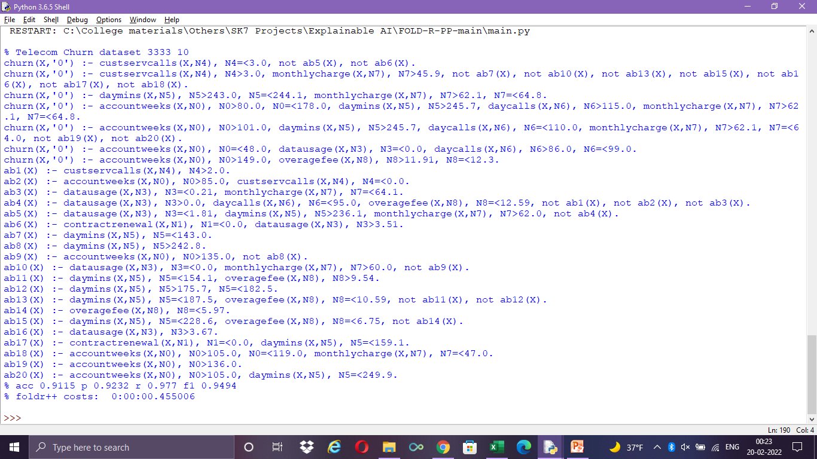
Telecom Churn – Fold-R++

Slide 26
Telecom Churn - Analysis
Except ‘DataPlan’, all other features are used for prediction of the target
Fifteen abnormal rules tells complexity of the dataset
There are exceptions nested inside exceptions
DateTime features seem to have more influence over the target variable
Model has more recall than the precision/recall
If all the dateTime features are used as dateTime rather than intergers, would improve the model’s performance

Slide 27
Customer Segmentation- About
The sales team has classified all customers into 4 segments (A, B, C, D ). Predict the right group of the new customers
Dataset contains 8068 records and 11 columns namely ID, Gender, Ever_Married, Age, Graduated, Profession, Work_Experience, Spending_Score, Family_Size and class (Var_1)
Since ID is column is not needed for the model, it is ignored from the set of attributes
'Age', 'Work_Experience', 'Spending_Score', 'Family_Size‘ features in this dataset are numerical features.
‘Cat_6’ is the most occuring target class(65%), so chosen as pos
This problem statement in kaggle has train and test datasets split

Slide 28
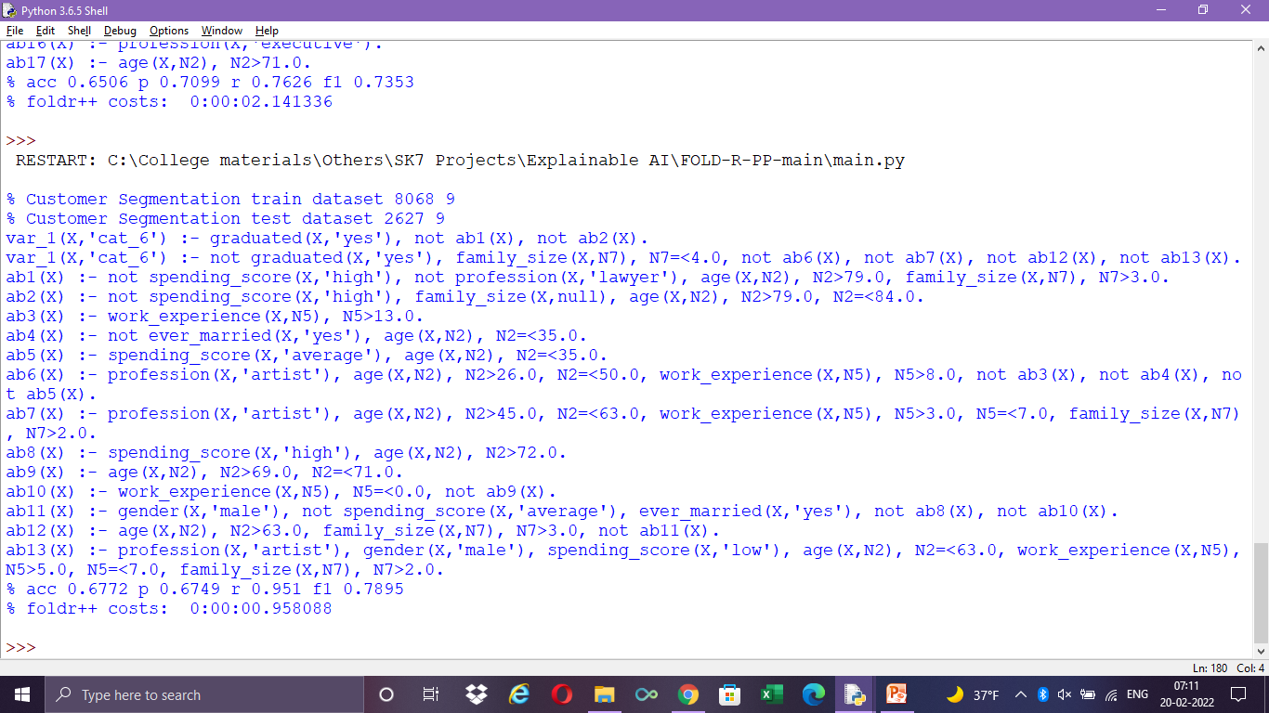
Customer Segmentation – Fold-R++

Slide 29
Customer Segmentation- Analysis
All features are being used for prediction of the target
Seventeen abnormal rules tells complexity of dataset
There are exceptions nested inside exceptions
Though precison/accuracy is low, recall is over 95% (Recall is considered to be imprortant metric)
By changing the ratio parameter of model from 0.5 to 0.7, recall has been improved from 73 to 95

Slide 30
Water Quality Prediction - About
Given the proportion of different elements present in the water, predict whether water is sfe or unsafe
Dataset contains 7999 records and 21 columns which include differnet elements like aluminium, ammonia, aresenic, etc.., and class (is_safe)
All the features in the dataset are numeric
‘0’ is the most occuring target class(88.5%), so chosen as pos

Slide 31
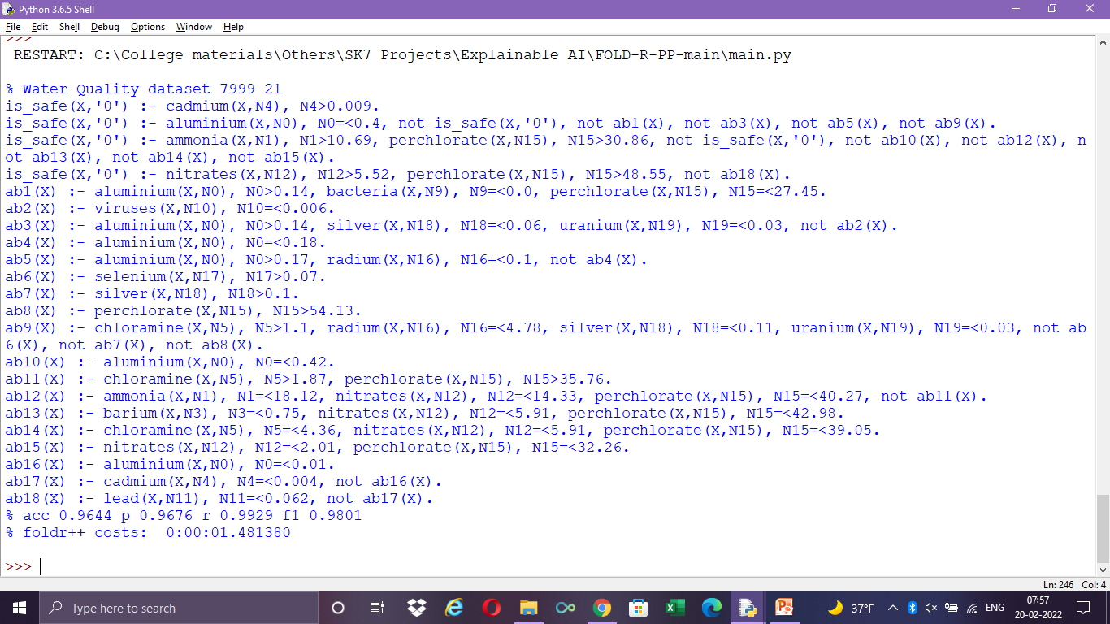
Water Quality Prediction – Fold-R++

Slide 32
Water Quality - Analysis
All features are being used for prediction of the target
Eighteen abnormal rules tells complexity of dataset
Every abnormal rule has conjunctions of several feaures. This shows the correlation among features
There are exceptions nested inside exceptions
Recall is higher than precision/accuracy

Slide 33
Stress Detection - About
Predict stress level based on different parameters measured during sleep
Dataset contains 630 records and 9 columns namely snoring rate, respiration rate, body temperature, limbb movement, blood oxygen, eye movement, sleeping hours, heart rate and class (stress level)
All the features in the dataset are numeric
Each class occurs at equal proportion in the dataset. so any class can be chosen as pos

Slide 34
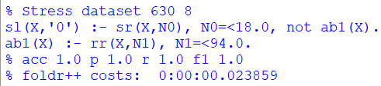
Stress Detection – Fold-R++

Slide 35
Stress Detection - Analysis
Only snoring and respiratory rates are being used for prediction of the target
Only one abnormal rule is generated
100% performance is achieved by juat 2 rules
Since dataset was equally split among all 5 classes and dataset was well distributed, it was easy for the model to generate rules to achieve 100% accuracy

Slide 36
Diabetes Classification - About
Predict a Model to detect Person has Diabetes or Not based on differnet body features
Dataset contains 2000 records and 9 columns namely Pregnancies, Glucose, BloodPressure, SkinThickness, Insulin, BMI, DiabetesPedigreeFunction, Age and class (Outcome)
All the features in the dataset are numeric
‘0’ is the most occuring target class(88.5%), so chosen as pos

Slide 37
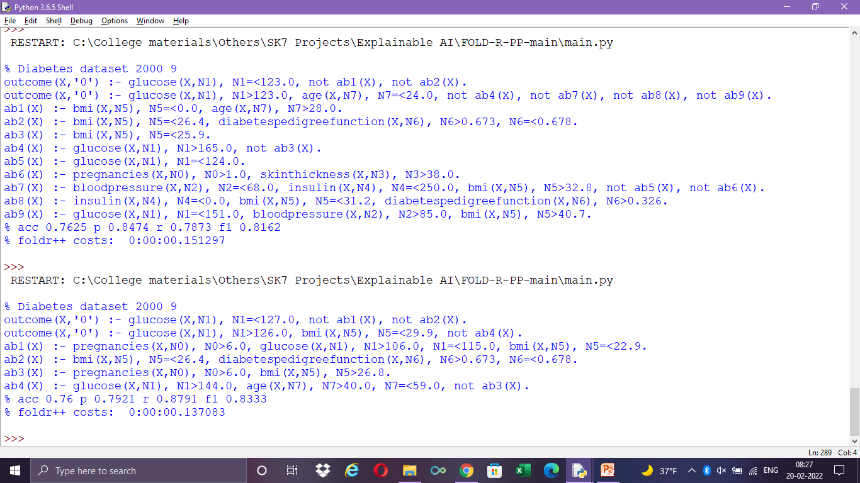
Diabetes Classiifcation – Fold-R++

Slide 38
Diabetes Classificartion - Analysis
BloodPressure, SkinThickness and Insulin are not being used for prediction of the target
Only four abnormal rules are generated
By changing the ratio parameter of model from 0.5 to 0.7, recall has been improved from 78 to 87
There are exceptions nested inside exceptions
Recall is higher than precision/accuracy

Slide 39
Summary
Fold-R++ algorithm is implemented over 12 datasets
Maximum number of records a dataset had was for the “Insurance Claim Approval” with 63326 records
Maximum number of columns a dataset had was for the “Water Quality Prediction” with 21 columns
Maximum number of abnormal(exceptions) rules was for the “Employee Stay Prediction” with 25 exceptions
Out of 12 datasets, 8 datasets have 90+ f1-score
Performance could be improved by adding preprocessing steps (stadardizing numerical columns for instance)

